Slide 1
IMAGE PROCESSING & COMPUTER VISION

Slide 2
WHAT IS AN IMAGE?

Slide 3
WHAT IS AN IMAGE?
An image is a 2-D light intensity function f( x, y).
An image is considered as Matrix.
A digital image f( x, y) is described both in
spatial co-ordinates and Brightness.
The points in the image and element value of matrix
identifies gray level value at that point.
This element is called Pixels.
So f( x, y)=R( x, y) *I(x, y)
Where R Reflectivity of Surface (Pixel Point)
I Intensity of incident Light

Slide 4
MATRIX OR DIGITAL REPRESENTATION OF IMAGE
An Image has infinite intensity value.
Also infinite picture point -How its stored.
Digitization of image.
Spatial discretization by Sampling.
Intensity discretization by Quantization.

Slide 5
MATRIX AS AN IMAGE
A matrix is an image for DIP

Slide 6
TYPES OF DIGITAL IMAGES
Binary Image: Each Pixel is just Black and white, i.e. 0 or 1
<462x493 logical>
Gray Scale Image: Each Pixel is shade of Gray, its 0(black) to white(255),i.e. each pixel~8 bits
<462x493 unit8>
Color Image or RGB Image, Each pixel corresponds to 3 values.
<462x493x3 unit8>

Slide 7
LEVEL OF IMAGE UNDERSTANDING
Low Level - Involve primitive operations.
e.g. Image Preprocessing, noise reduction, enhancement etc.
Input: Image - Output: Image
Mid Level-
Image segmentation, identify particular objects.
Input: Image – Output: Attributes extracted from those images. e.g. edges, contour, identify etc.
High Level-Involving making sense of an ensemble of recognize objects, image analysis and far end the functions normally associated with human vision.

Slide 8
HISTORY LET’S LOOK BACK WHEN DOES DIP STARTED

Slide 9
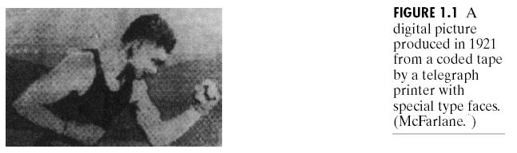
HISTORY OF IMAGE PROCESSING
Its not young field, In 1920 submarine cables were used to transmit digitalized newspaper pictures between London and New-Work-Use Telegraphic Printing.
In 1921 –Improved in printing, use photographic printing to enhance the quality and resolution.
Early digital image

Slide 10
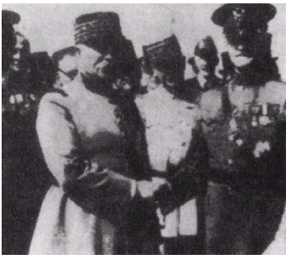
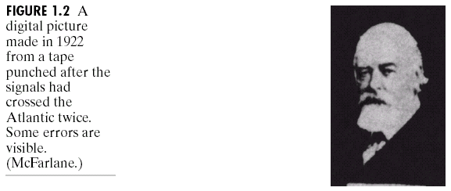
HISTORY OF IMAGE PROCESSING
Mid to late 1920s: Improvements to the Bartlane system resulted in higher quality images
New reproduction processes based on photographic techniques
Increased number of tones in reproduced images
Improved digital image
Early 15 tone digital image

Slide 11
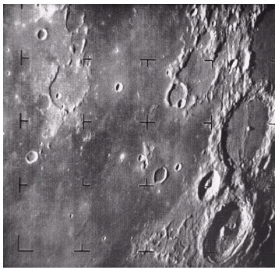
HISTORY OF IMAGE PROCESSING
1960s: Improvements in computing technology and the onset of the space race led to a surge of work in digital image processing
1964: Computers used to improve the quality of images of the moon taken by the Ranger 7 probe at JET PROPULSION LAB
Such techniques were used in other space missions including the Apollo landings
it’s the real beginning…
A picture of the moon taken by the Ranger 7 probe minutes before landing

Slide 12
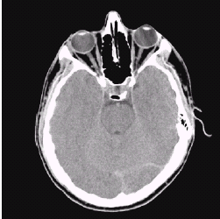
HISTORY OF IMAGE PROCESSING
1970s: Digital image processing begins to be used in medical applications
1979: Sir Godfrey N. Hounsfield & Prof. Allan M. Cormack share the Nobel prize in medicine for the invention of tomography, the technology behind computerised axial tomography (CAT) scans
Typical head slice CAT image

Slide 13
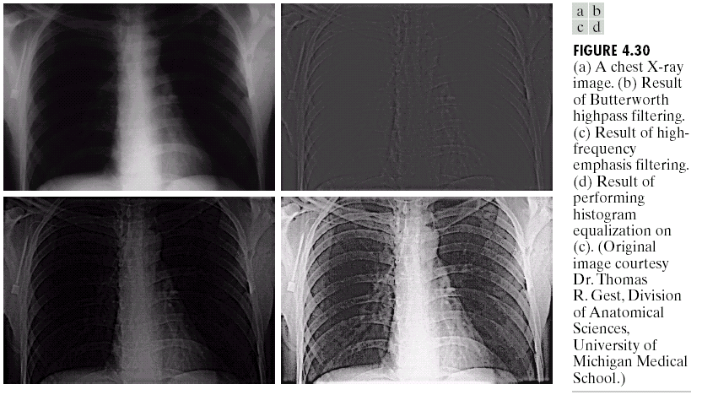
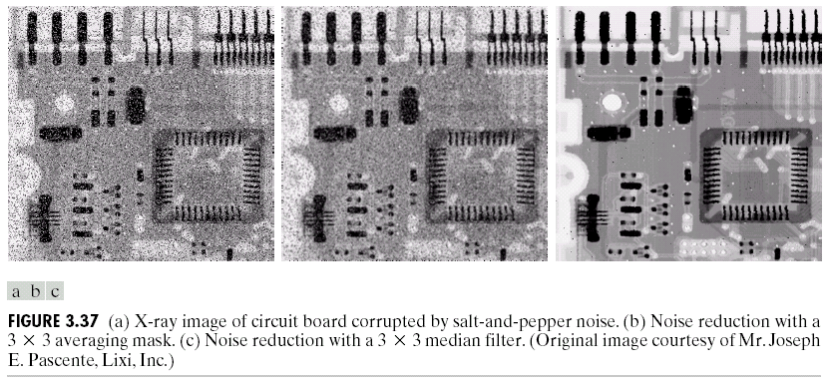
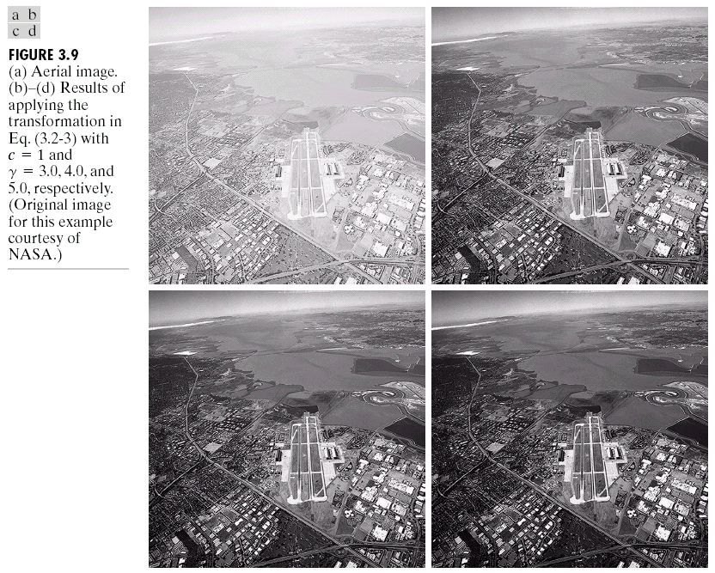
HISTORY OF IMAGE PROCESSING
1980s - Today: The use of Digital Image Processing techniques has exploded and they are now used for all kinds of tasks in all kinds of areas
Image enhancement/restoration
Artistic effects
Medical visualisation
Industrial inspection
Law enforcement
Human computer interfaces

Slide 14
KEY STAGES OF DIGITAL IMAGE PROCESSING

Slide 15
KEY STAGES OF DIP

Slide 16
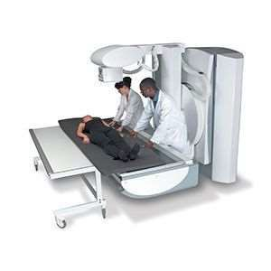
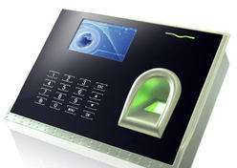
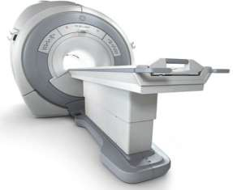

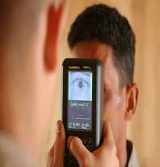
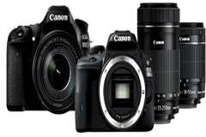
IMAGE ACQUISITION
This is the first step or process of the fundamental steps of digital image processing.
Image acquisition could be as simple as being given an image that is already in digital form.
Involves preprocessing, such as scaling etc.

Slide 17
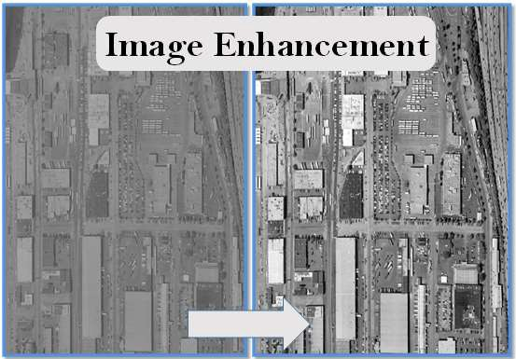
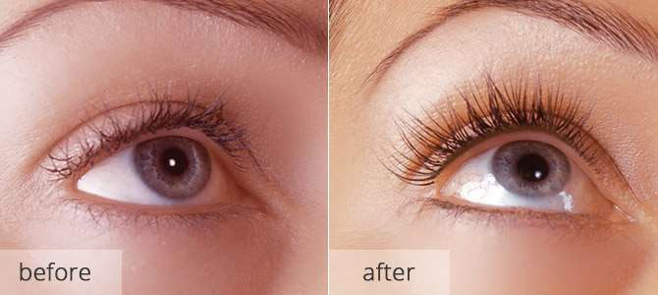
IMAGE ENHANCEMENT
To bring out detail that is obscured, or simply to highlight certain features of interest in an image such as, changing brightness & contrast etc.
Process an image to produce a better result that is suitable for a particular application. Tasks involve:
Sharpening or de-blurring an out of focus image
Highlighting edges
Improving image contrast ; brightening an image
Removing noise

Slide 18
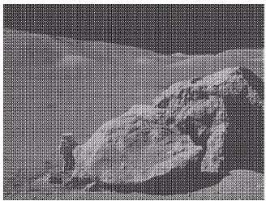
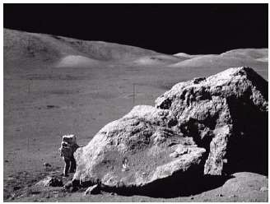

IMAGE RESTORATION
Image restoration attempts to restore images that have been degraded
Identify the degradation process and attempt to reverse it.
Almost Similar to image enhancement, but more objective
Fig: Degraded image
Fig: Restored image

Slide 19

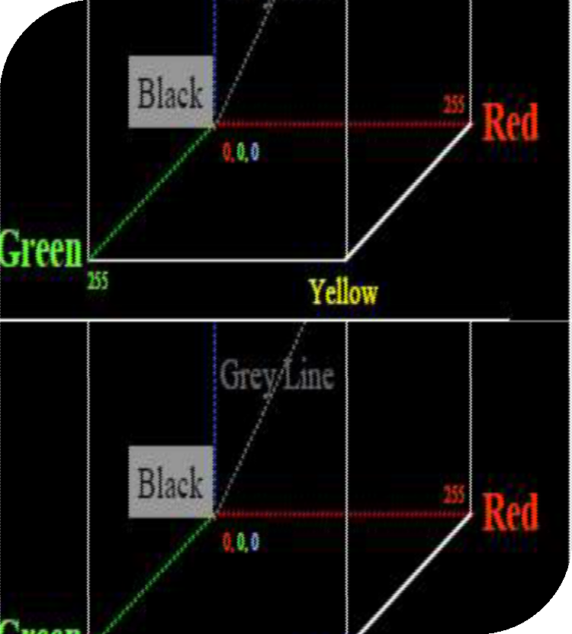
COLOR IMAGE PROCESSING
Red, Green and Blue Color cube
Consider Each element=8 bit
R,G,B ~0 to 255
Grey scale f(x , y , L)
256 Grey shades
Color Scale f(x , y, r , g , b)-24 bit
255x255x255=16777216 colors
19

Slide 20
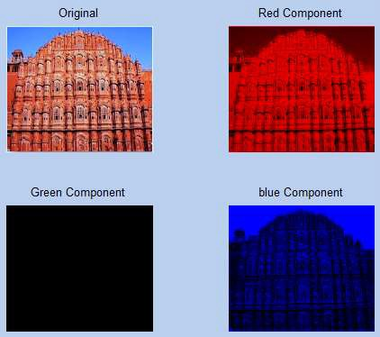
RGB COMPONENTS OF AN IMAGE
20

Slide 21
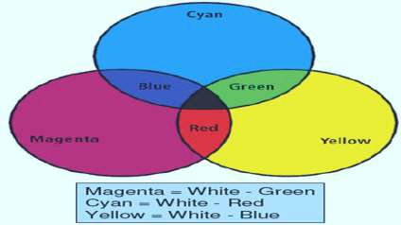
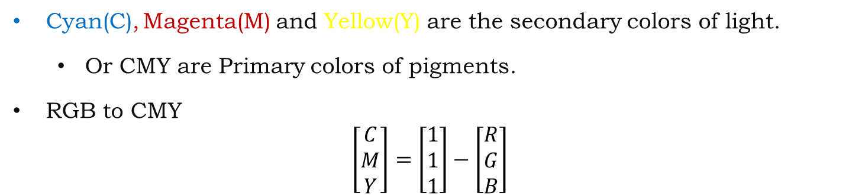
CMY AND CMYK COLOR MODEL
Cyan(C), Magenta(M) and Yellow(Y) are the secondary colors of light.
Or CMY are Primary colors of pigments.
RGB to CMY
$$\left[\begin{matrix}C \\ M \\ Y\end{matrix}\right]=\left[\begin{matrix}1 \\ 1 \\ 1\end{matrix}\right]−\left[\begin{matrix}R \\ G \\ B\end{matrix}\right]$$
Black=Cyan + Magenta + Yellow
Printing Industry used to four color Printing.
Cyan, Magenta, Yellow plus Black.

Slide 22
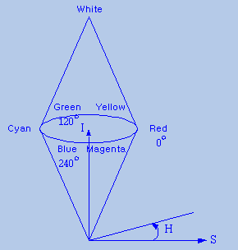
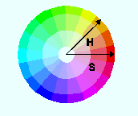
HIS COLOR MODEL
RGB to HSI Conversion
3
I = ¹ (R + G + B), where0 ≤ I , R,G, B ≤ 1
¹ [(R − G) + (R − B)]
H = cos⁻¹{ ² },
(R − G)² + (R − B)(G − B)
0 0
if g > b
0 0
H = 360 □ − H , if g < b
where g₀ = G / I , b₀ = B / I
S = 1−
3
×(min{R,G, B})
R + G + B
-Hue : Range [0, 360]
-Saturation : Range[0, 1]
-Intensity : Range[0, 1]

Slide 23


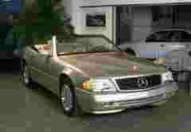
IMAGE COMPRESSION
How we stored the image: Reduce the size for storage .
How analog image world is relate to digital processing world.
Compression-Remove redundancies.
Transmission with minimum bandwidth.
Lossy Compression=redundancy +some information, but still acceptable
Original Image Size-116 KB
Compressed Image Size-12.9 KB, 11 %
Compressed Image Size-1.95 KB, 1.6 %

Slide 24
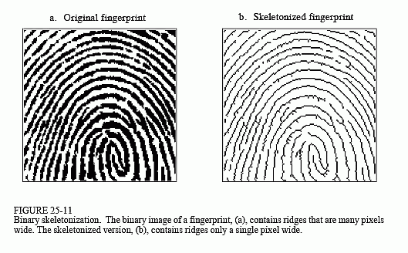
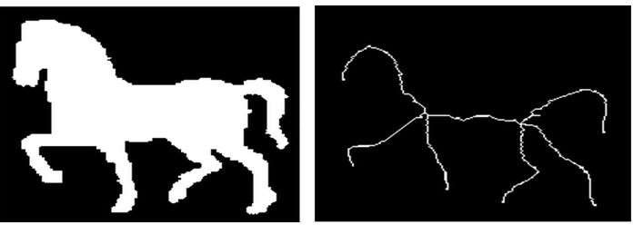
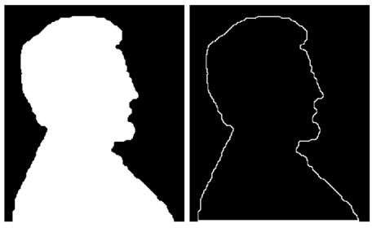
MORPHOLOGICAL IMAGE PROCESSING
Boundaries extraction
Skeletons
Convex hull
Morphological filtering
Thinning
Pruning…many More

Slide 25
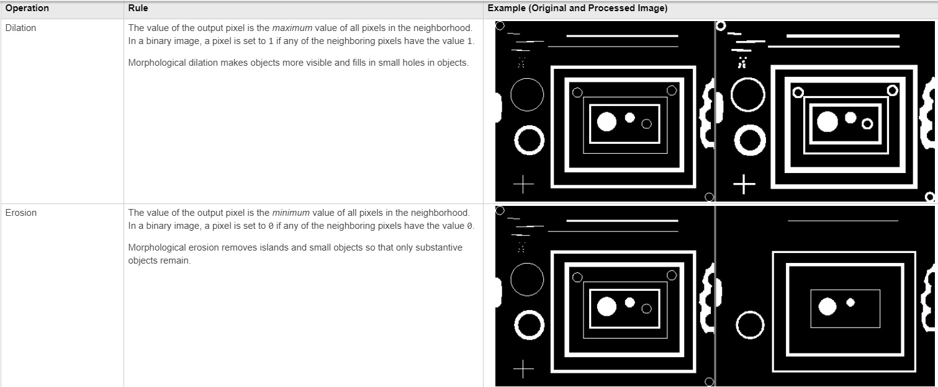
MORPHOLOGICAL IMAGE PROCESSING

Slide 26
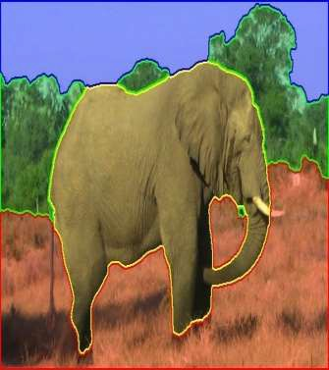
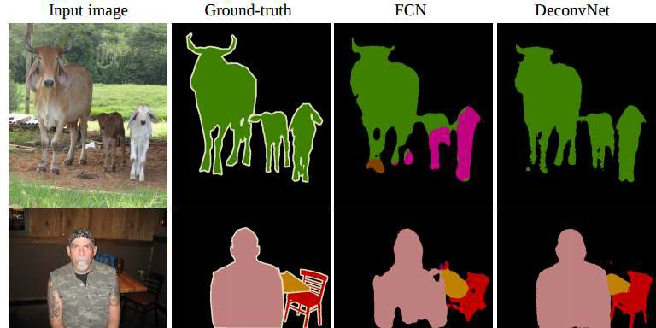
IMAGE SEGMENTATION
In computer vision, Image Segmentation is the process of partitioning a digital image into multiple segments. The goal of segmentation is to simplify and/or change the representation of an image into something that is more meaningful and easier to analyze.

Slide 27
IMAGE REPRESENTATION AND DESCRIPTION
After an image is segmented into regions; the resulting aggregate of segmented pixels is represented and described for further computer processing.
Representing regions in 2 ways:
Based on their external characteristics (its boundary):
Shape characteristics
Based on their internal characteristics (its region):
Regional properties: color, texture, and …
Both

Slide 28
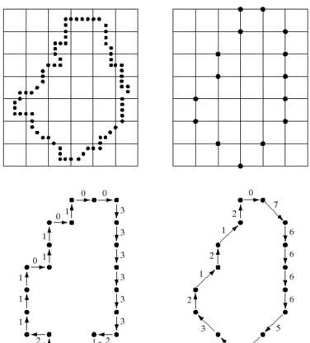
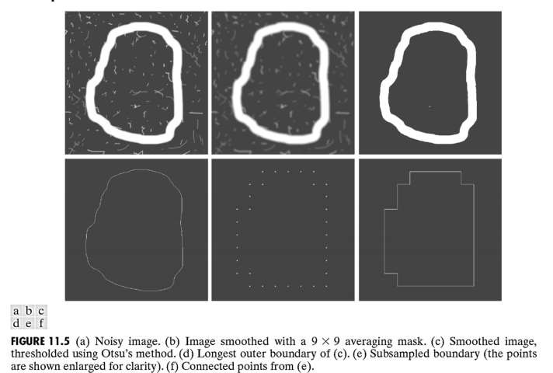
IMAGE REPRESENTATION AND DESCRIPTION

Slide 29
OBJECT RECOGNITION
Object Detection is the process of finding instances of objects in images. This allows for multiple objects to be identified and located within the same image.
Object Recognition can be termed as identifying a specific object in a digital image or video. Object recognition have immense of applications in the field of monitoring and surveillance, medical analysis, robot localization and navigation etc.

Slide 30
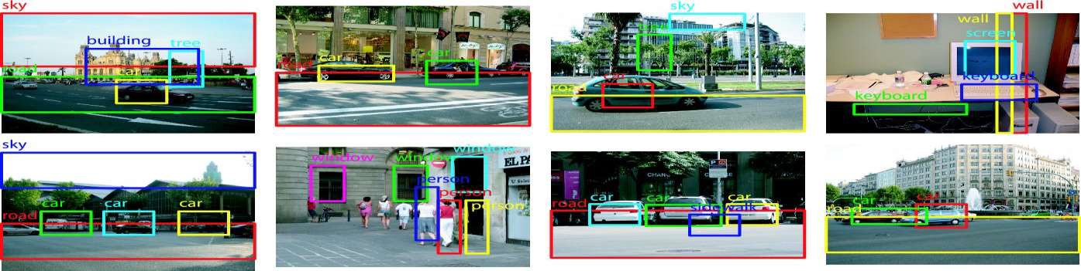
OBJECT RECOGNITION

Slide 31
COMPUTER VISION

Slide 32
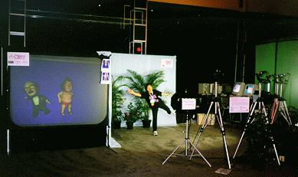
WHAT IS COMPUTER VISION?
Deals with the development of the theoretical and algorithmic basis by which useful information about the 3D world can be automatically extracted and analyzed from a single or multiple to 2D images of the world.

Slide 33
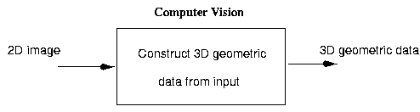
COMPUTER VISION
Concerned with the theory behind artificial systems that extract information from images
Examples of applications of CV:
Controlling process
Detecting events
Organizing information
Modeling objects or environments
Interaction
Produces 3D models from image data

Slide 34
COMPUTER VISION, ALSO KNOWN AS ...
Image analysis
Scene analysis
Image understanding

Slide 35
SOME RELATED DISCIPLINES
Image processing
Computer graphics
Pattern recognition
Robotics
Artificial intelligence

Slide 36
WHY IS COMPUTER VISION DIFFICULT?
It is a many-to-one mapping
A variety of surfaces with different material and geometrical properties, possibly under different lighting conditions, could lead to identical images
Inverse mapping has non unique solution (a lot of information is lost in the transformation from the 3D world to the 2D image)
It is computationally intensive
We do not understand the recognition problem
Notes:
Computer vision is a field that deals with trying to get computers to understand digital images and videos.
It’s very easy for us to see that it’s a picture of a (freaking adorable) dog running on grass. But it turns out that trying to get a computer to figure that out is an extremely difficult task. To explain why this is, I will first explain to how an image is represented on a computer.
Every pixel in an image contains a colour. Every colour can be represented by 3 numbers ranging from 0–255. I can write these numbers in the form (n1, n2, n3), which represent red, green, and blue values, respectively. For example, (255,0,0) represents the colour red, (0,255,0) represents green, and (0,0,255) represents blue. Using different values for these numbers, you can create whatever colour you want.
So, if every pixel contains a colour, that means every pixel is described by 3 numbers. So if we have an image that is 100x100 px, that means that this image is represented by 100*100*3=30000 numbers. Imagine being given 30000 numbers ranging from 0–255 and being told to figure out whether these numbers represent an image of a dog or a cat. Now you have an idea about why this is such a difficult task.
Over the past few years, we have actually made incredible advancements in solving this problem. More specifically, we have achieved very high success rates for image classification, which is the process of classifying an image into one of several pre-determined categories, through the use of convolutional neural networks (CNN’s). Basically, CNN’s are extremely large and complex mathematical models that we ‘train’ by feeding them thousands of labelled images, and allowing the computer to learn the labels. For example, if we wanted to classify images as either images of dogs or cats, we would train a CNN by feeding it tons of images of dogs and cats, along with their respective labels. Eventually, with the proper CNN architecture and training techniques, the CNN should be able to classify images it has never seen before as either a dog or a cat, with fairly high accuracy rates.
However, there is still a lot of room for improvement with our current computer vision techniques. Image segmentation, for example, is something that is still an extremely difficult task. Image segmentation is the process of locating and segmenting out objects in an image. See the image below for an example of this.
There are a number of different strategies to do this, but our current methods are nowhere near perfect.
Currently, computer vision is a very large area of research. You may have already noticed the impact that our advancements in this field of research have had. For example, most smartphones nowadays have automatic face detection so that when you take photos of people, your phone can automatically figure out who is in the picture. And for all you Android users, you can now search through your photos using keywords such as “mountains” or “beaches”, since Google now analyzes all your photos with state-of-the-art computer vision techniques (as an iPhone user, I must say that I am quite jealous of and amazed at this feature).
The more progress we make in this field, the more changes we will see in our lives. Tesla’s autonomous vehicles currently use incredibly advanced computer vision techniques in real-time to successfully navigate the streets using several different cameras on the car. While their current cars available to the public are not fully autonomous, once they perfect their algorithms (and after driverless car laws are passed), we will see completely autonomous cars all over the place.
There are so many different industries that can and will benefit from computer vision. Thanks to this amazing area of research, we already have face detection and partially driverless cars, and soon we will see fully driverless cars, stores without checkout lines, and so much more. There are so many amazing potential applications of computer vision, and I’m so excited to see what people are going to come up with.

Slide 37
PRACTICAL CONSIDERATIONS
Impose constraints to recover the scene
Gather more data (images)
Make assumptions about the world
Computability and robustness
Is the solution computable using reasonable resources?
Is the solution robust?
Industrial computer vision systems work very well
Make strong assumptions about lighting conditions
Make strong assumptions about the position of objects
Make strong assumptions about the type of objects

Slide 38
COMPUTER VISION APPLICATIONS
Industrial inspection/quality control
Surveillance and security
Face recognition
Gesture recognition
Space applications
Medical image analysis
Autonomous vehicles
Virtual reality and much more …...

Slide 39
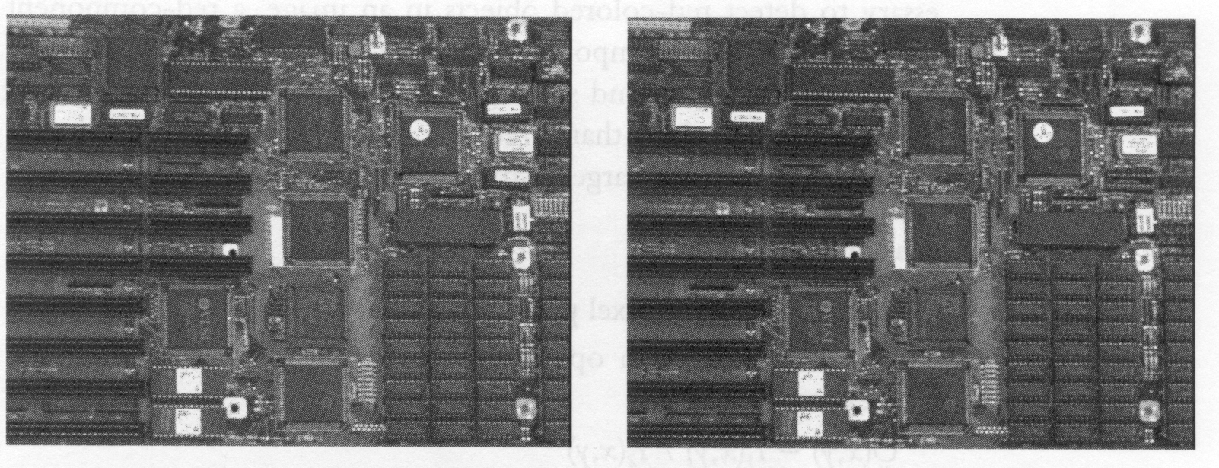

VISUAL INSPECTION

Slide 40


CHARACTER RECOGNITION

Slide 41
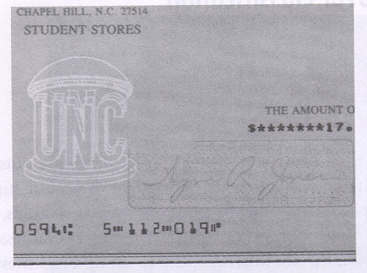
DOCUMENT HANDLING

Slide 42

SIGNATURE VERIFICATION

Slide 43
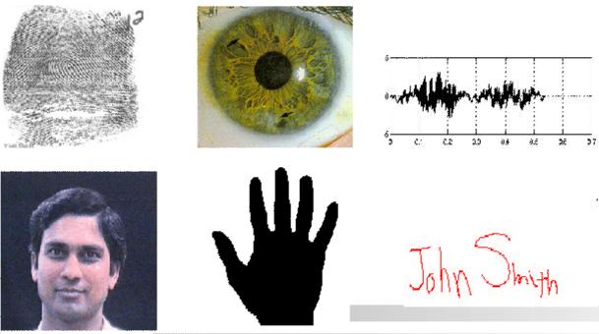
BIOMETRICS

Slide 44
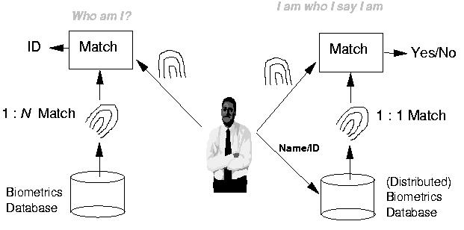
FINGERPRINT VERIFICATION / IDENTIFICATION

Slide 45
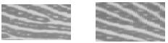
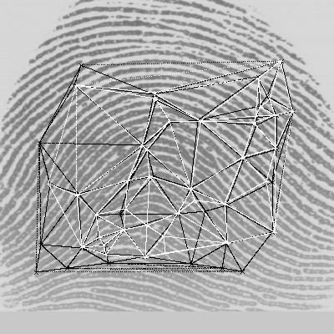
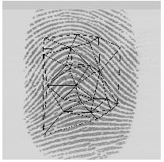
FINGERPRINT IDENTIFICATION
Minutiae Matching
Delaunay Triangulation

Slide 46

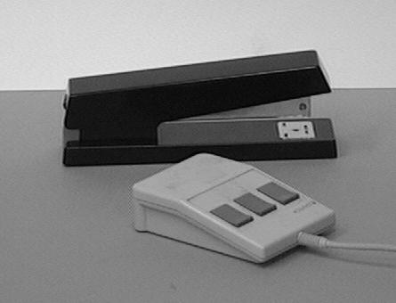
OBJECT RECOGNITION

Slide 47
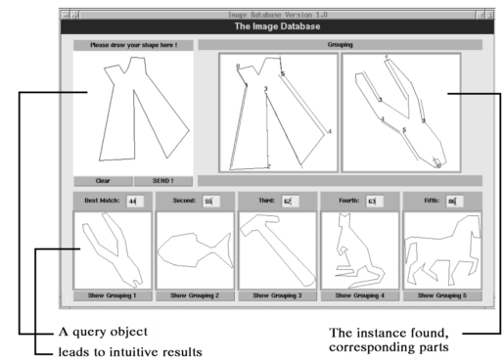
INDEXING INTO DATABASES
Shape content

Slide 48
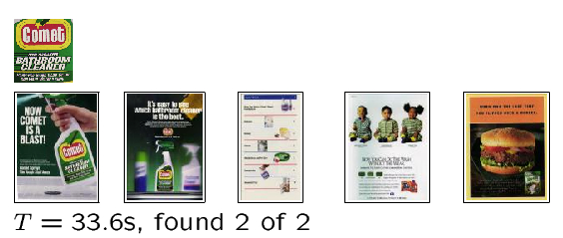
INDEXING INTO DATABASES
Color, texture

Slide 49
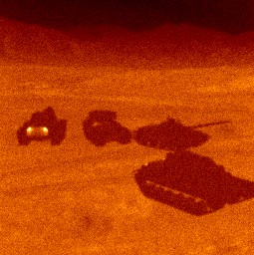
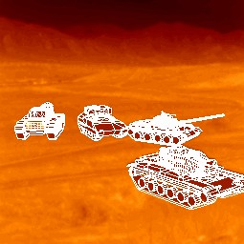
TARGET RECOGNITION
Department of defense (army, air force, navy)

Slide 50
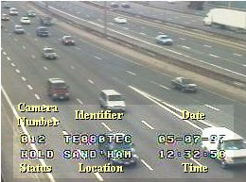
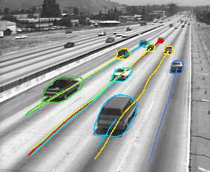
TRAFFIC MONITORING

Slide 51
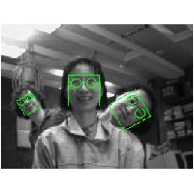

FACE DETECTION
Notes:
Face detection refers to computer technology that is able to identify the presence of people’s faces within digital images. In order to work, face detection applications use machine learning and formulas known as algorithms to detecting human faces within larger images. These larger images might contain numerous objects that aren’t faces such as landscapes, buildings and other parts of humans (e.g. legs, shoulders and arms).
Face detection is a broader term than face recognition. Face detection just means that a system is able to identify that there is a human face present in an image or video. Face detection has several applications, only one of which is facial recognition. Face detection can also be used to auto focus cameras. And it can be used to count how many people have entered a particular area. It can even be used for marketing purposes. For example, advertisements can be displayed the moment a face is recognized.
While the process is somewhat complex, face detection algorithms often begin by searching for human eyes. Eyes constitute what is known as a valley region and are one of the easiest features to detect. Once eyes are detected, the algorithm might then attempt to detect facial regions including eyebrows, the mouth, nose, nostrils and the iris. Once the algorithm surmises that it has detected a facial region, it can then apply additional tests to validate whether it has, in fact, detected a face.

Slide 52

FACE RECOGNITION
Notes:
One of the most important applications of face detection, however, is facial recognition. Face recognition describes a biometric technology that goes way beyond recognizing when a human face is present. It actually attempts to establish whose face it is. The process works using a computer application that captures a digital image of an individual’s face (sometimes taken from a video frame) and compares it to images in a database of stored records. While facial recognition isn’t 100% accurate, it can very accurately determine when there is a strong chance that an person’s face matches someone in the database.
There are lots of applications of face recognition. Face recognition is already being used to unlock phones and specific applications. Face recognition is also used for biometric surveillance. Banks, retail stores, stadiums, airports and other facilities use facial recognition to reduce crime and prevent violence.
So in short, while all facial recognition systems use face detection, not all face detection systems have a facial recognition component.

Slide 53



FACE DETECTION/RECOGNITION

Slide 54

FACIAL EXPRESSION RECOGNITION

Slide 55

HUMAN ACTIVITY RECOGNITION

Slide 56


MEDICAL APPLICATIONS
skin cancer breast cancer

Slide 57


MORPHING
http://www.morphthing.com/
Notes:
Morphing is a special effect in motion pictures and animations that changes (or morphs) one image or shape into another through a seamless transition.
Morphing is an image processing technique used for the metamorphosis from one image to another. The idea is to get a sequence of intermediate images which when put together with the original images would represent the change from one image to the other. The simplest method of transforming one image into another is to cross-dissolve between them. In this method, the color of each pixel is interpolated over time from the first image value to the corresponding second image value. This is not so effective in suggesting the actual metamorphosis. For morphs between faces, the metamorphosis does not look good if the two faces do not have the same shape approximately.

